Slide 1
Lotka-Volterra Competition
West Chester University of Pennsylvania
Corey Zhang

Slide 2
Introduction
The competitive Lotka–Volterra equations are a simple model of the population dynamics of species competing for some common resource.

Slide 3
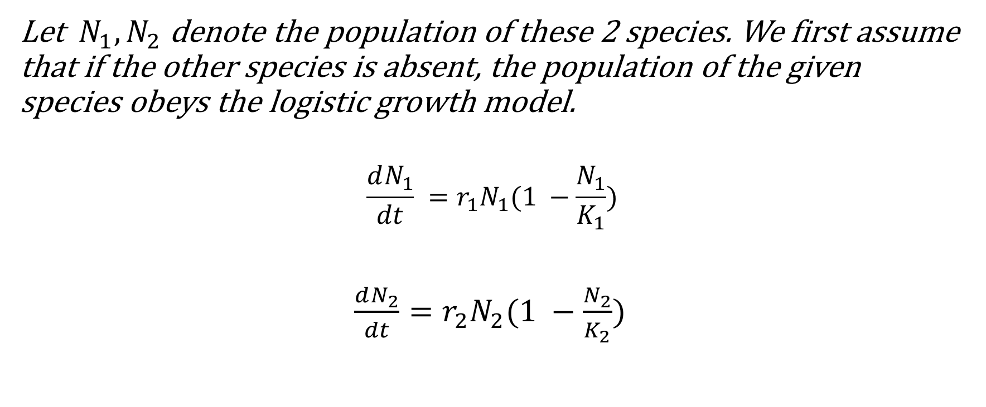
Derivation
Let $N_{1},N_{2}$ denote the population of these 2 species. We first assume that if the other species is absent, the population of the given species obeys the logistic growth model.
$$\frac{dN_{1}}{dt} =r_{1}N_{1}(1 −\frac{N_{1}}{K_{1}})$$
$\frac{dN_{2}}{dt}=r_{2}N_{2}(1 −\frac{N_{2}}{K_{2}})$
r: inherent per-capita growth rate
K: carrying capacity

Slide 4
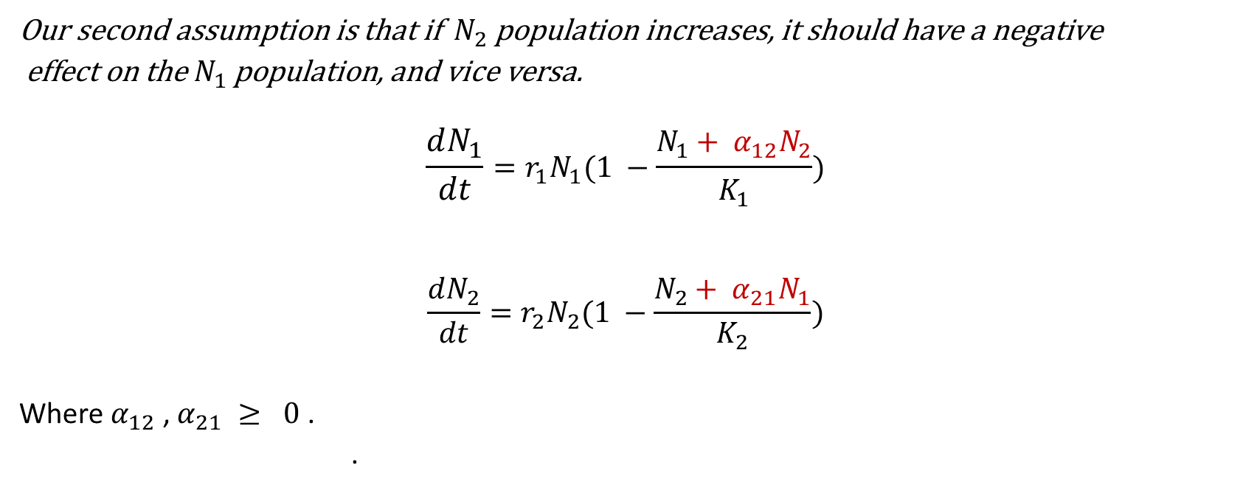
Derivation
Our second assumption is that if ${ N}_{2}$population increases, it should have a negative
effect on the $N_{1}$ population, and vice versa.
$$\frac{dN_{1}}{dt}=r_{1}N_{1}(1 −\frac{N_{1}+ α_{12}N_{2}}{K_{1}})$$
$$\frac{dN_{2}}{dt}=r_{2}N_{2}(1 −\frac{N_{2}+ α_{21}N_{1}}{K_{2}})$$
Where $α_{12}$ , $α_{21} ≥ 0$ .
.

Slide 5

Derivation
Or can be written as:
$$\frac{dN_{1}}{dt}=\frac{r_{1}}{K_{1}}N_{1}(K_{1}−N_{1}− α_{12}N_{2})$$
$$\frac{dN_{2}}{dt}=\frac{r_{2}}{K_{2}}N_{2}(K_{2}−N_{2}− α_{21}N_{1})$$

Slide 6
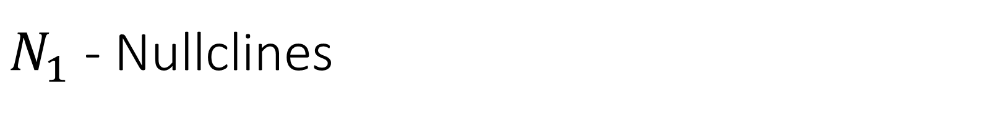

$N_{1}$ - Nullclines
$$0=\frac{r_{1}}{K_{1}}N_{1}(K_{1}−N_{1}− α_{12}N_{2})$$
$N_{1}$ = 0
or
$N_{1}$ = $K_{1}$ $− α_{12}N_{2}$

Slide 7



$N_{1}$ - Nullclines
$$0=\frac{r_{1}}{K_{1}}N_{1}(K_{1}−N_{1}− α_{12}N_{2})$$
$N_{1}$ = 0 or
$N_{1}$ = $K_{1}$ $− α_{12}N_{2}$
$$N_{2}$$
$$N_{1}$$

Slide 8


$N_{1}$ - Nullclines
$$0=\frac{r_{1}}{K_{1}}N_{1}(K_{1}−N_{1}− α_{12}N_{2})$$
$N_{1}$ = 0 or
$N_{1}$ = $K_{1}$ $− α_{12}N_{2}$
$$N_{2}$$
$$\frac{K_{1}}{α_{12}}$$
$$N_{1}$$
$$K_{1}$$

Slide 9

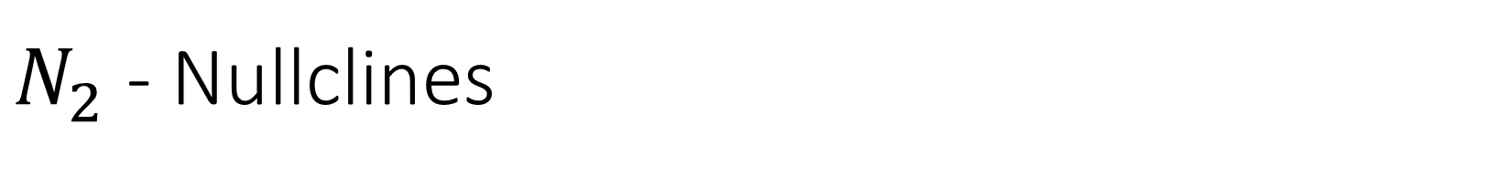
$N_{2}$ - Nullclines
$$0=\frac{r_{2}}{K_{2}}N_{2}(K_{2}−N_{2}− α_{21}N_{1})$$
$N_{2}$ = 0
or
$N_{2}$ = $K_{2}$ $− α_{21}N_{1}$

Slide 10

$N_{2}$ - Nullclines
$$0=\frac{r_{2}}{K_{2}}N_{2}(K_{2}−N_{2}− α_{21}N_{1})$$
$N_{2}$ = 0
or
$N_{2}$ = $K_{2}$ $− α_{21}N_{1}$
$$N_{2}$$
$$N_{1}$$

Slide 11


$N_{2}$ - Nullclines
$$0=\frac{r_{2}}{K_{2}}N_{2}(K_{2}−N_{2}− α_{21}N_{1})$$
$N_{2}$ = 0
or
$N_{2}$ = $K_{2}$ $− α_{21}N_{1}$
$$N_{2}$$
$$K_{2}$$
$$N_{1}$$
$$\frac{K_{2}}{α_{21}}$$

Slide 12
























$$N_{2}$$
$$N_{2}$$
$$K_{2}$$
①
$$K_{2}$$
②
$$\frac{K_{1}}{α_{12}}$$
$$\frac{K_{1}}{α_{12}}$$
$$N_{1}$$
$$N_{1}$$
$$N_{2}$$
$$\frac{K_{2}}{α_{21}}$$
$$N_{2}$$
$$K_{1}$$
$$\frac{K_{2}}{α_{21}}$$
$$K_{1}$$
$$\frac{K_{1}}{α_{12}}$$
$$\frac{K_{1}}{α_{12}}$$
③
④
$$K_{2}$$
$$K_{2}$$
$$N_{1}$$
$$N_{1}$$
$$\frac{K_{2}}{α_{21}}$$
$$K_{1}$$
$$K_{1}$$
$$\frac{K_{2}}{α_{21}}$$

Slide 13
References
Contributors to Wikimedia projects. “Competitive Lotka–Volterra Equations - Wikipedia.” Wikipedia, the Free Encyclopedia, Wikimedia Foundation, Inc., 17 Dec. 2004, https://en.wikipedia.org/wiki/Competitive_Lotka%E2%80%93Volterra_equations.
German A. Enciso, Ph.D. Mathematical Biology. 13: Lotka Volterra Competiton. YouTube, 10 Feb. 2014, https://www.youtube.com/watch?v=p4Y9b8sgnOU.
Kot, Mark. Elements of Mathematical Ecology. Cambridge University Press, 2001, pp. 198–219.

